Slide 1

Building The Untethered, Always-On AI Companion
Team Member:
Rohan Kumar Singh
Aditya Goswami
Kumar Rishi
Siddhant Gaurav Mishra
Notes:
slidesppt.net

Slide 2
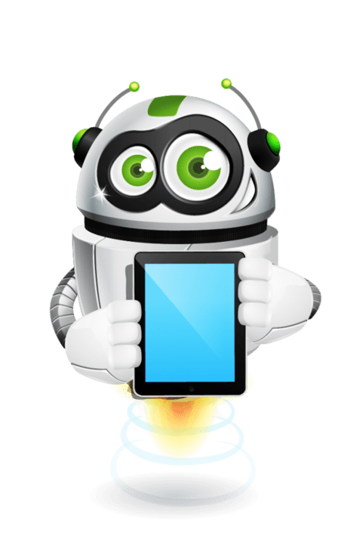
INTRODUCTION
Arch Assistant is a custom AI-powered voice assistant designed to integrate multiple AI models and APIs (such as Gemini).
It has been developed as a desktop-based assistant with speech recognition, conversational capabilities, and future expandability to hardware platforms like STM32 and ESP32.
The assistant can function like a personal AI similar to Alexa, but customizable.
CHATBOT
Notes:
slidesppt.net

Slide 3
COMPONENTS USED
- Python 3.x - PyAudio (for microphone access)
- SpeechRecognition (for speech-to-text)
- Pyttsx3 (for text-to-speech)
- Wikipedia API (for fetching information)
- NumPy, SciPy (for signal processing)
- Gemini API integration
- Future scope: LLaMA models, HuggingFace deployment, STM32/ESP hardware integration
CHATBOT
Notes:
slidesppt.net

Slide 4
FEATURES IMPLEMENTED
-Real-time speech-to-text recognition
-Conversational AI response generation
-Integration with APIs (like Gemini)
-Wikipedia knowledge integration
-Text-to-speech natural responses
-Modular design for easy model integration
-Works on desktop with Pycharm IDE setup
CHATBOT
Notes:
slidesppt.net

Slide 5
WORKFLOW
User speaks into the microphone
Audio is captured using PyAudio
Processed by AI model like Gemini
Converted into text using SpeechRecognition
CHATBOT
AI generates a response
Response is converted into speech using pyttsx3
Output delivered to the user as a natural conversation
Notes:
slidesppt.net

Slide 6
FUTURE REFORMS
-Adding advanced conversational abilities (memory, context retention)
-Integrating open-source LLaMA 4 models
-Deploying on HuggingFace cloud for remote access
-Hardware integration with STM32 and ESP32 for IoT/embedded systems
-Expanding capabilities to control home appliances
-Enhancing natural voice interaction (Alexa-like experience)
- Adding multi-language support
CHATBOT
Notes:
slidesppt.net

Slide 7
BENEFITS
- Fully customizable AI assistant
- Open-source and flexible for researchers and developers
- Works with multiple AI providers (not locked to one ecosystem)
- Scalable to embedded hardware platforms
- Can be used in education, IoT, accessibility solutions, and smart assistants
CHATBOT
Notes:
slidesppt.net

Slide 8
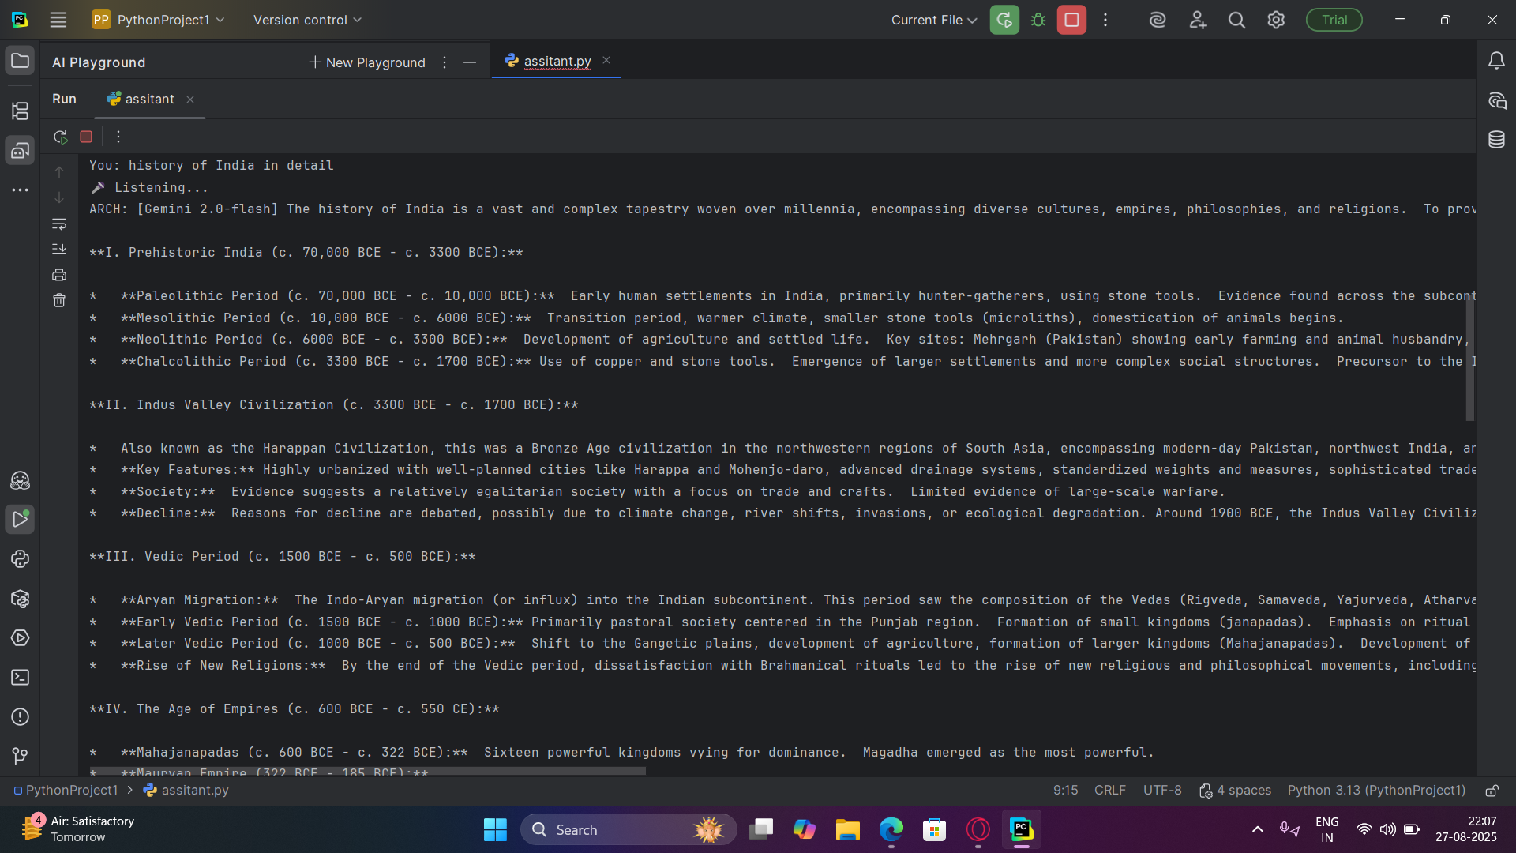
RESULTS
CHATBOT
Notes:
slidesppt.net

Slide 9
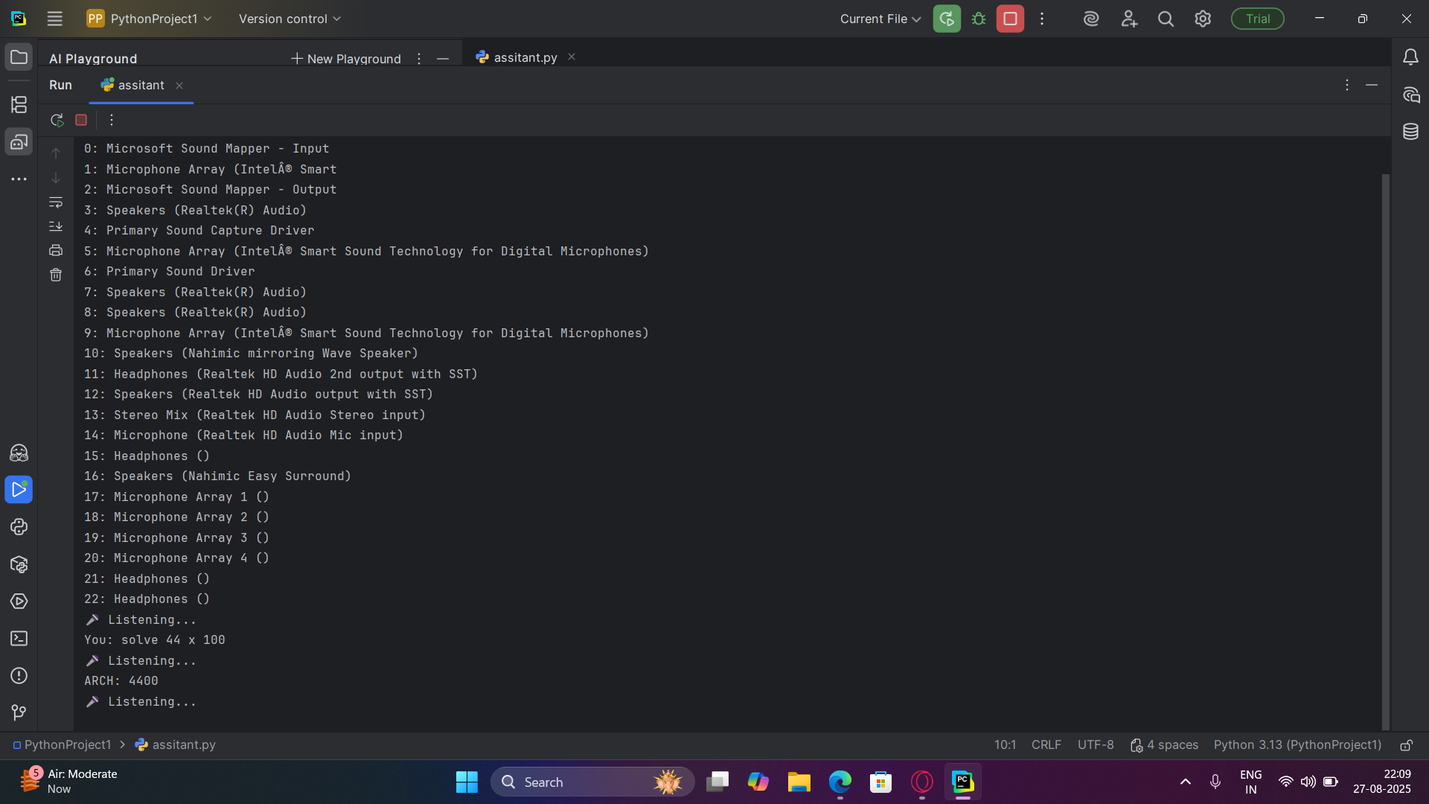
RESULTS
CHATBOT
Notes:
slidesppt.net

Slide 10
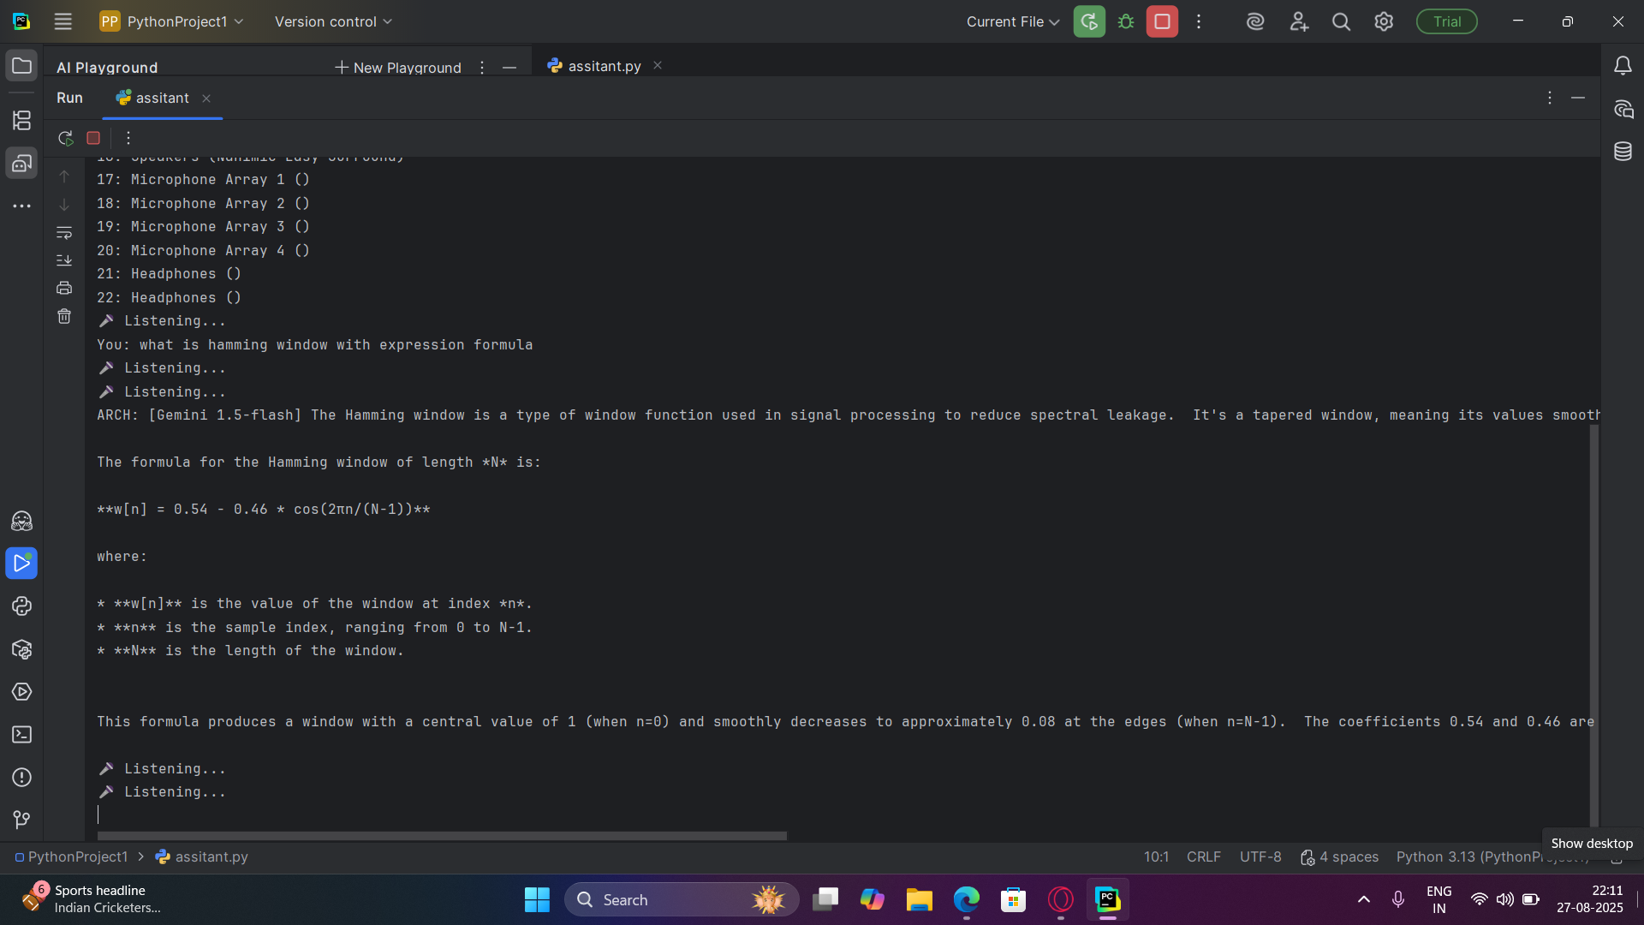
RESULTS
CHATBOT
Notes:
slidesppt.net

Slide 11
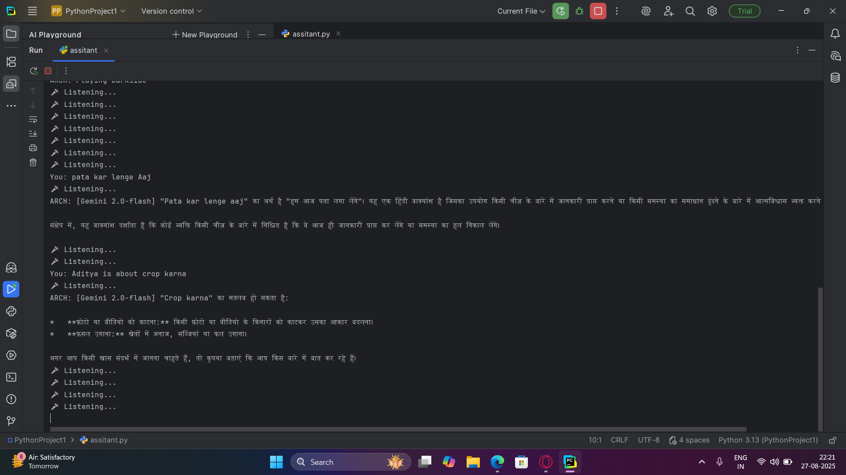
RESULTS
CHATBOT
Notes:
slidesppt.net

Slide 12
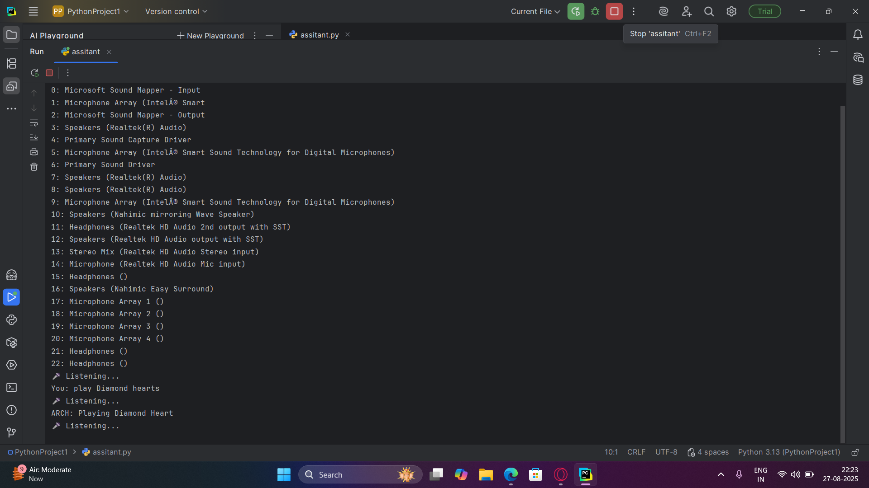
RESULTS
CHATBOT
Notes:
slidesppt.net

Slide 13
CONCLUSION
The Arch Assistant project demonstrates the creation of a modular, multi-model AI assistant that can evolve into a full-fledged Alexa-like system. With future reforms such as hardware integration, LLaMA support, and enhanced conversational memory, Arch Assistant has the potential to become a personal, open-source AI assistant platform.
CHATBOT
Notes:
slidesppt.net

Slide 14
THANK
YOU
Notes:
slidesppt.net

